Slide 1




Instagram Analytics
Presented By: Kanchan Sinha

Slide 2

Description
Instagram aims to introduce new features and launch an advertising campaign centered around user engagement.
To facilitate this, they have tasked the data analytics team with analyzing user interactions and engagement within the Instagram app to address specific questions and deliver valuable insights that can drive business growth.

Slide 3
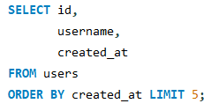
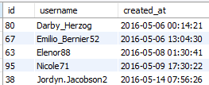
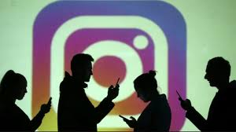
Identify the five oldest users on Instagram from the provided database.

Slide 4
Insights
There are total 26 people who never posted a single photo.
Recommendations
Encourage inactive users to start posting by sending them promotional Emails.
Hosting interactive events or challenges to encourage photo sharing could foster community and prompt increased user activity.

Slide 5
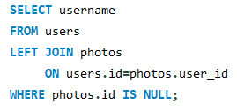
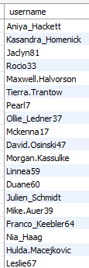
Identify users who have never posted a single photo on Instagram.
There are total 26 people who never posted a single photo.
Encourage inactive users to start posting by sending them promotional Emails.

Slide 6

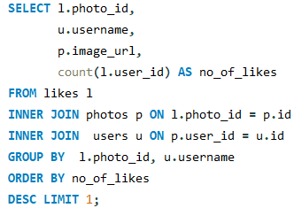

Determine the winner of the contest.
The team has organized a contest where the user with the most likes on a single photo wins.

Slide 7
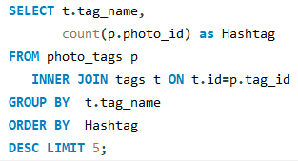
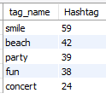
Identify and suggest the top five most commonly used hashtags on
the platform.

Slide 8
Recommendations
Use these hashtags to create posts that resonate with audience.
Initiate a challenge encouraging users to post their content using these hashtags. For example, a “#SmileChallenge” where users share their happiest moments.
Analyze the audience associated with these hashtags and create targeted marketing campaigns around the themes of fun, celebration, and community engagement.

Slide 9
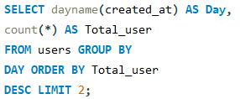

Determine the day of the week when most users register on Instagram
Top 2 days of week to launch ads are Thursday and Sunday.

Slide 10


Investor Metrics

Slide 11
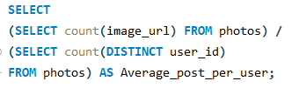
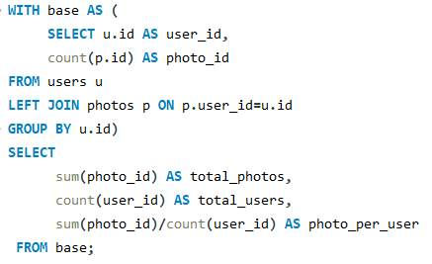


Calculate the average number of posts per user on Instagram. Also, provide the total number of photos on Instagram divided by the total number of users.

Slide 12
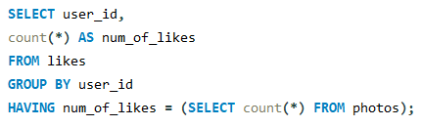
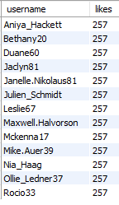
Identify users (potential bots) who have liked every single photo on the site, as this is not typically possible for a normal user.

Slide 13
Recommendations
Prompt suspicious users to verify their accounts through CAPTCHA or two-factor authentication to confirm they are real users.
Notify users who may have been affected by bot activity, particularly if bots have liked their posts, to maintain transparency and trust.
Consider suspending or removing accounts confirmed to be bots after careful review.

Slide 14
THANK YOU

